Slide 1

Recognizes Global Talent
www.reelage.com

Slide 2
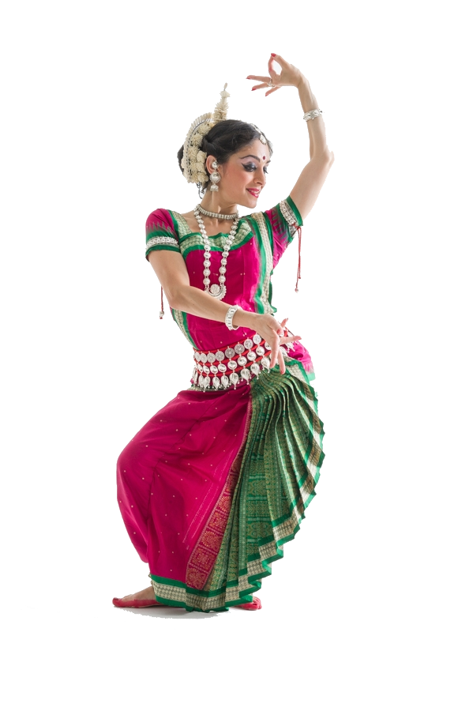

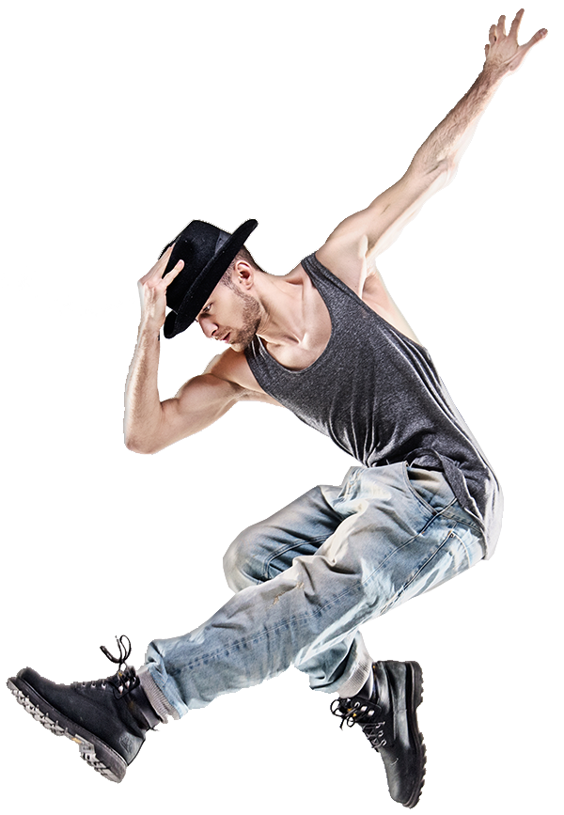
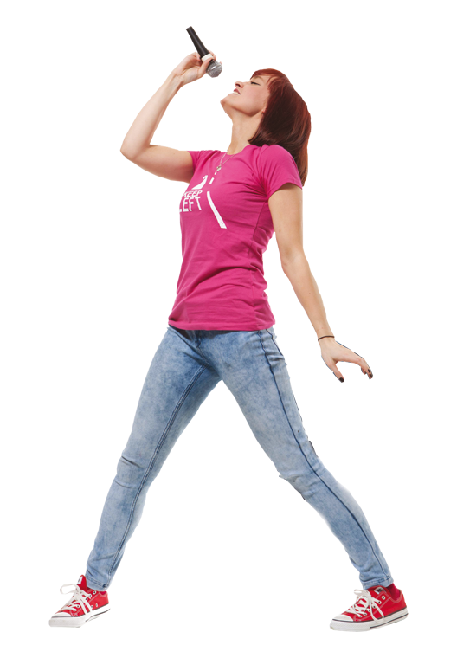


It’s all about your talent.
www.reelage.com

Slide 3




Mission
To create the most celebrated online platform to discover, showcase & reward talent from across the globe.
Participate
Win
Grow
www.reelage.com

Slide 4

Video Market Landscape
1.9 billion Internet video users by 2021.
3 trillion minutes of video viewed per month by 2021.
Memorable for people 43% - Video 18% - Text 36% - Image
76% - marketers who benefited with increase in sales through videos.
www.reelage.com

Slide 5

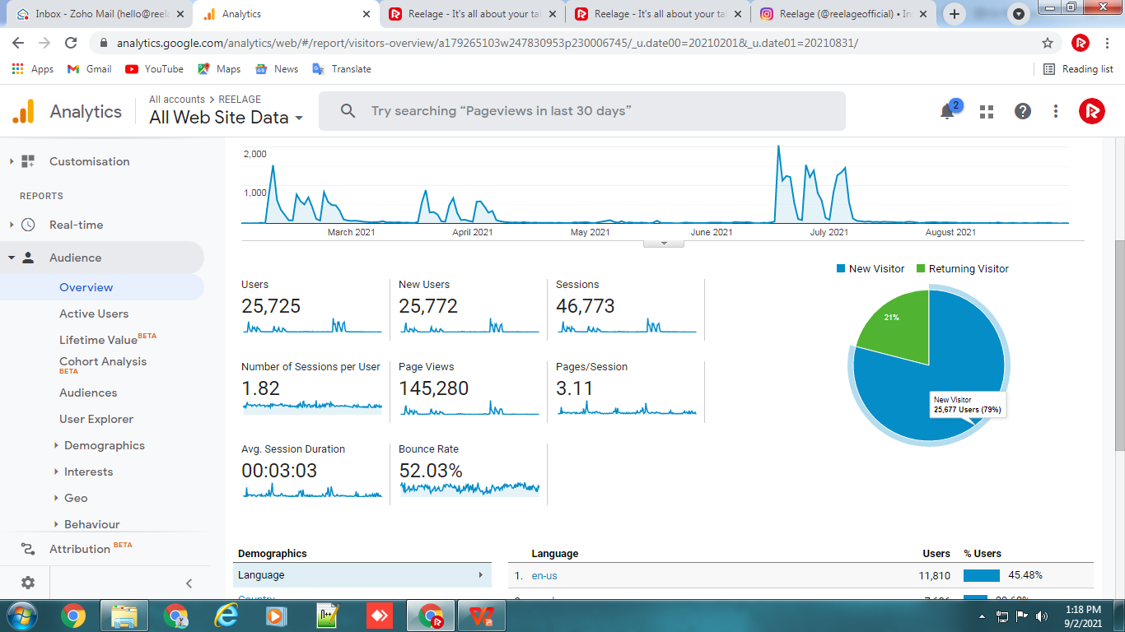
Metrics – Overall
(Last Three Competitions User Data January 2021 – July 2021 )
Total Number of Registration on Website: 4122
www.reelage.com

Slide 6
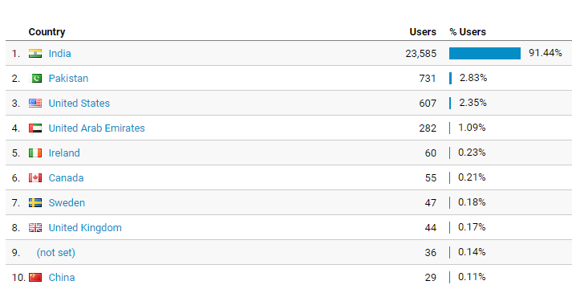
Country Wise Traffic
(Last Three Competitions User Data January 2021 – July 2021 )
www.reelage.com

Slide 7
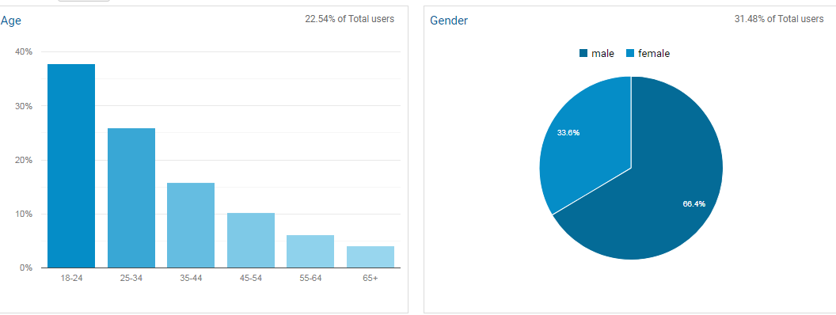
Age and Gender Wise Traffic
(Last Three Competitions User Data January 2021 – July 2021 )
www.reelage.com

Slide 8
Collaboration Advantages
Brand Exposure
Boost in Sales
Increased Traffic
Heightened Visibility
www.reelage.com

Slide 9

COMPETITIONS BY REELAGE
www.reelage.com

Slide 10
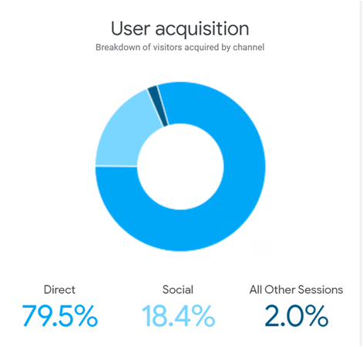
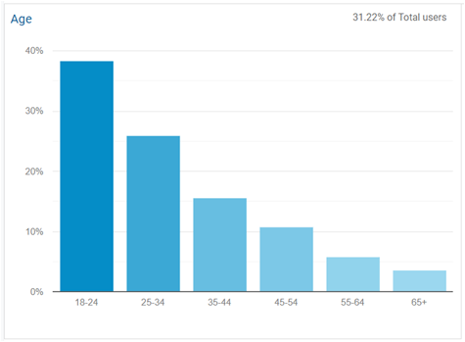
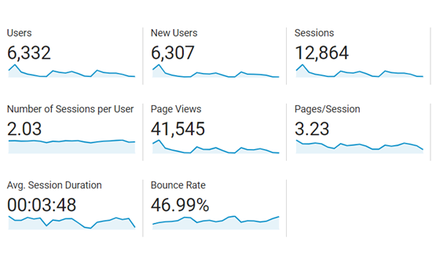
Metrics – Let’s Dance (February 2021)
12,864 - No. of sessions
3.48 - Avg session duration in mins
746 - Hours of stay time
>1,000 – Registrations
6,332 - Unique users
26 - Participants
www.reelage.com

Slide 11
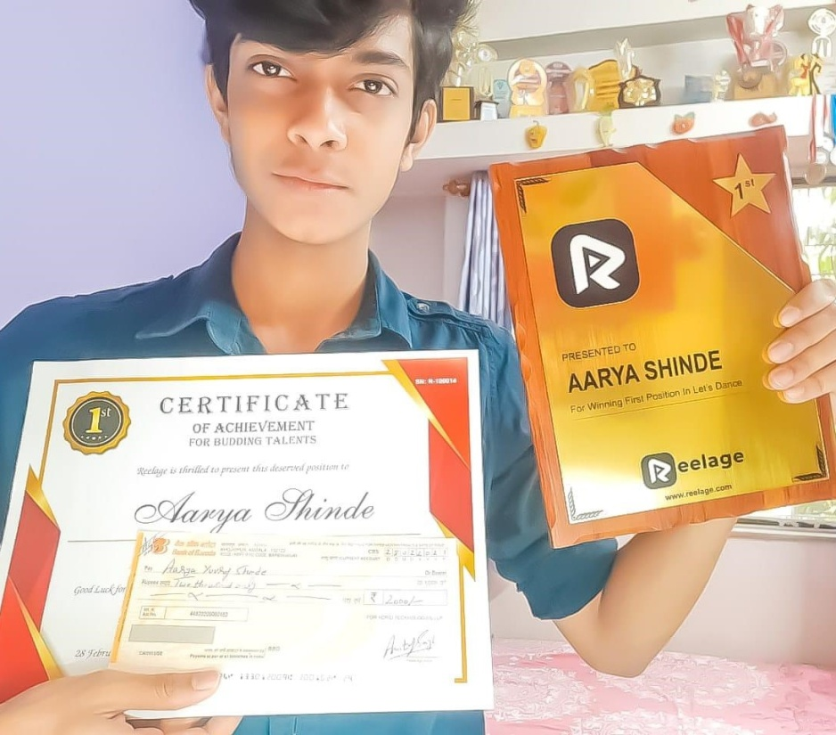
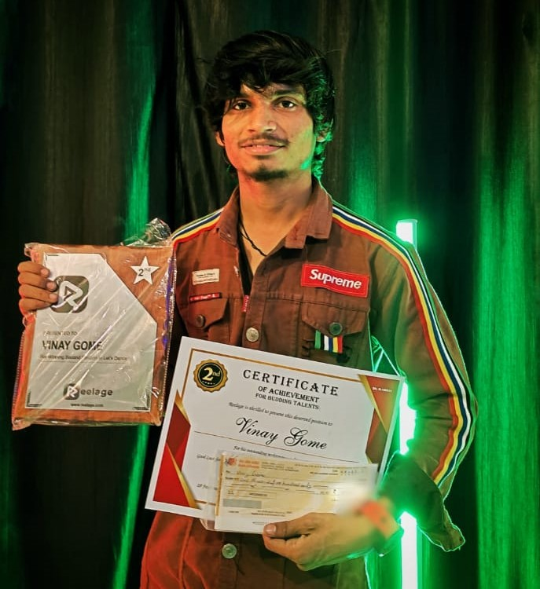
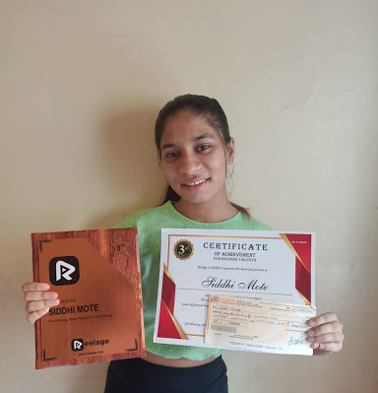
Celebrated Winners
Aarya Shinde Gold
Vinay Gome Silver
Siddhi Mote Bronze
www.reelage.com

Slide 12
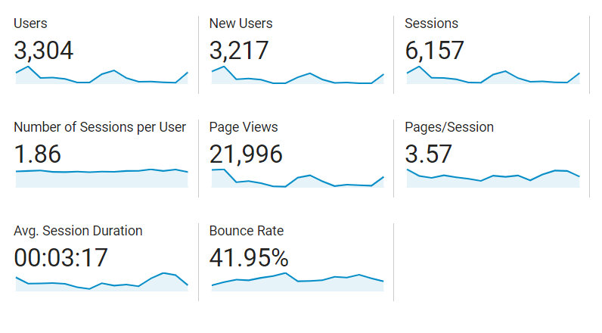
Metrics – The Voice Sensation (March - April 2021)
6,157 - No. of sessions
3.17 - Avg session duration in mins
325 - Hours of stay time
>1,000 – Registrations
3,304 - Unique users
62 - Participants
www.reelage.com

Slide 13
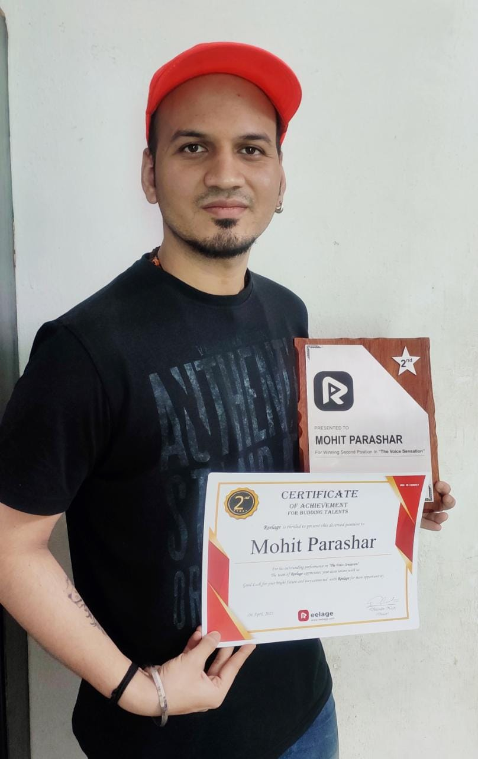
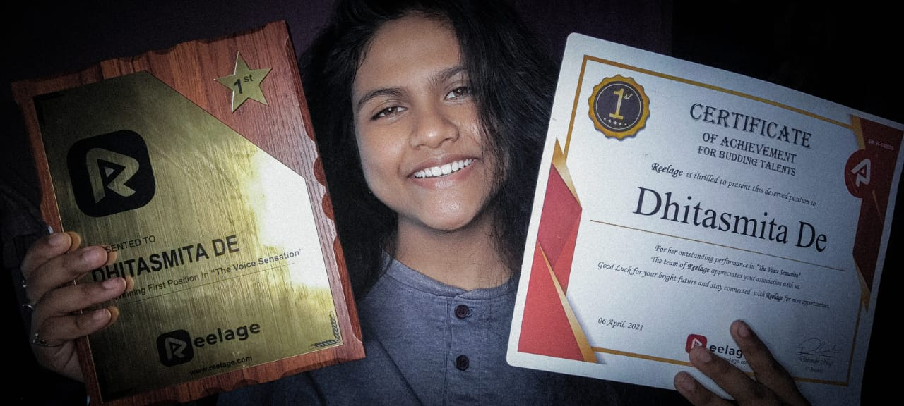
Celebrated Winners
Dhitasmita De Gold
Mohit Parashar Silver
www.reelage.com

Slide 14
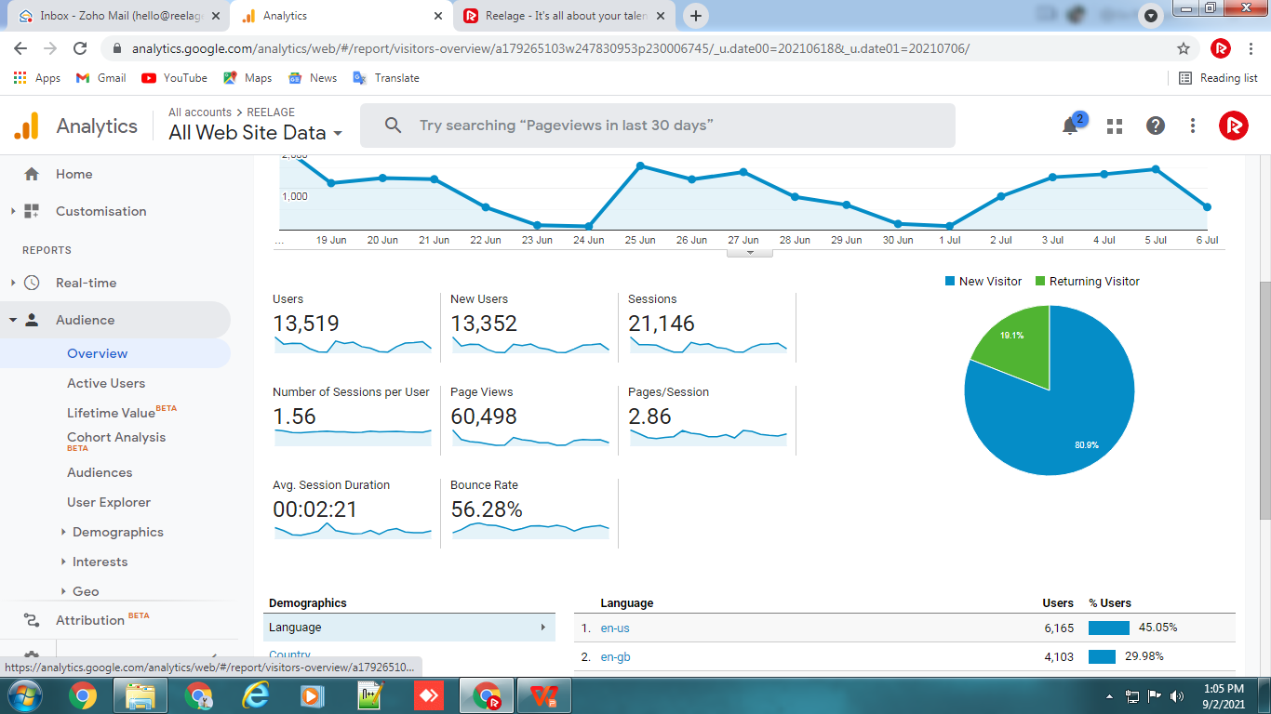
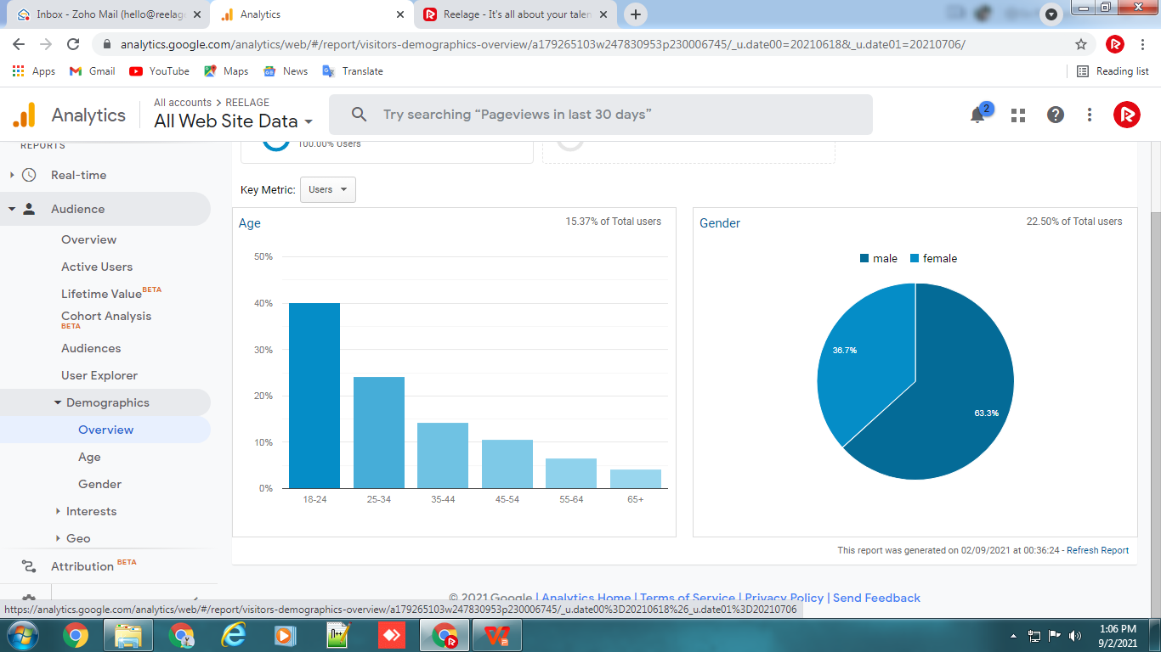
Metrics – The Dance Idol
(June - July 2021)
>1,000 – Registrations
6,332 - Unique users
66 - Participants

Slide 15

Celebrated Winners
www.reelage.com

Slide 16
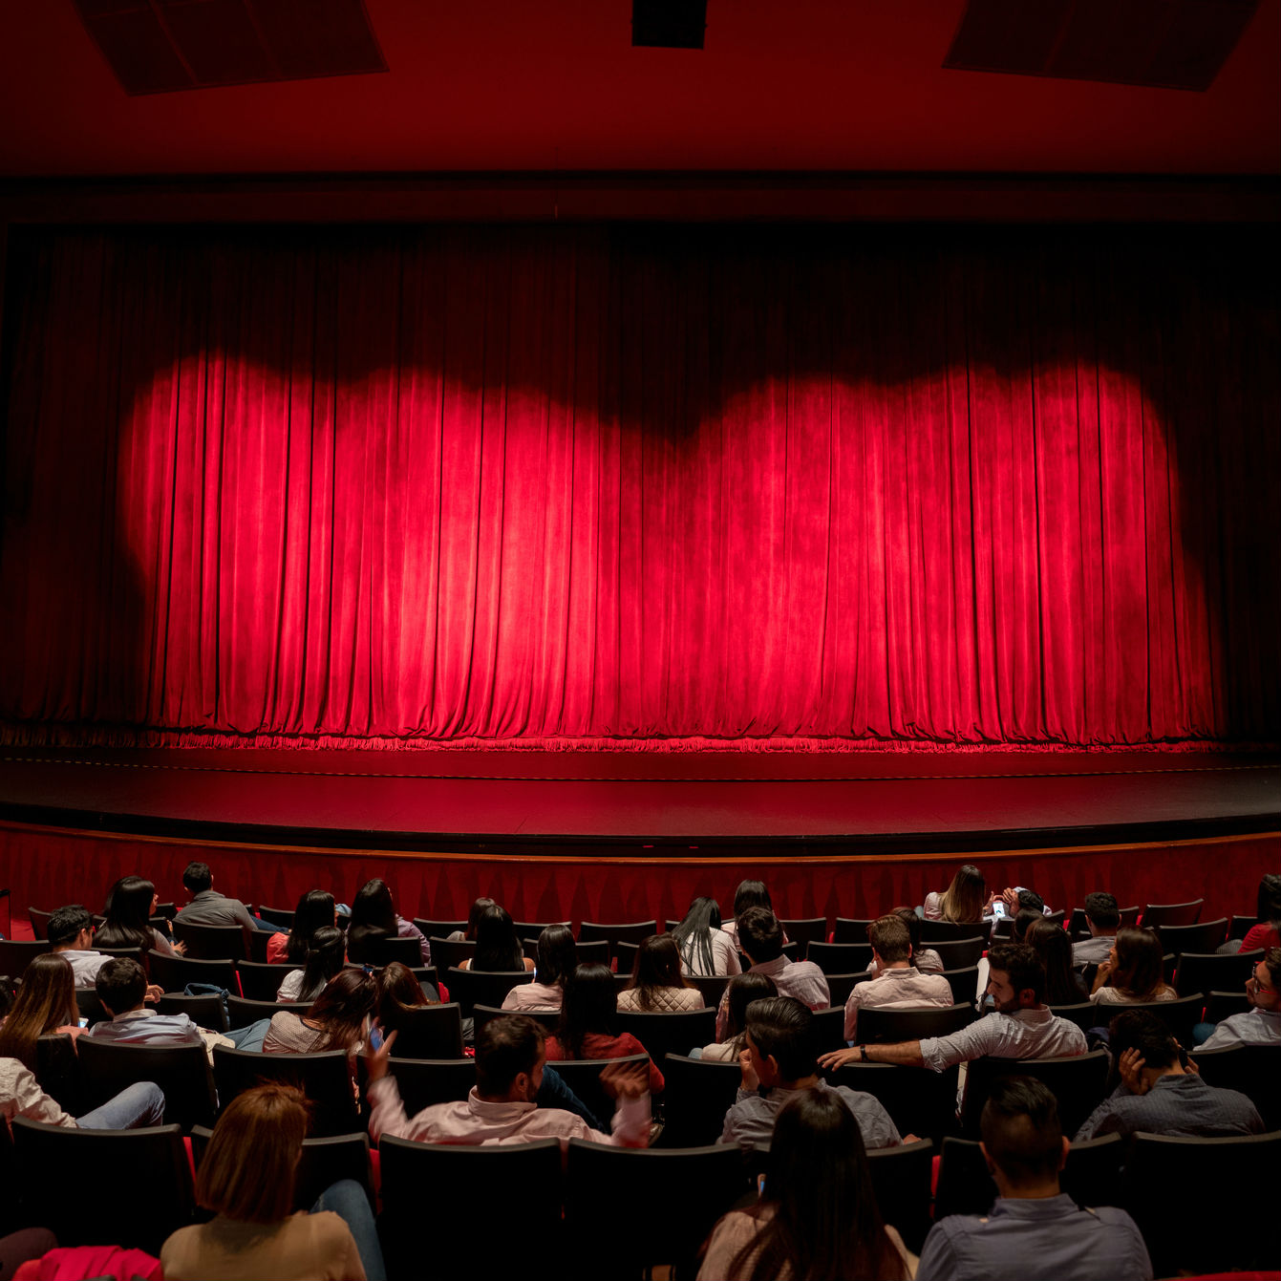

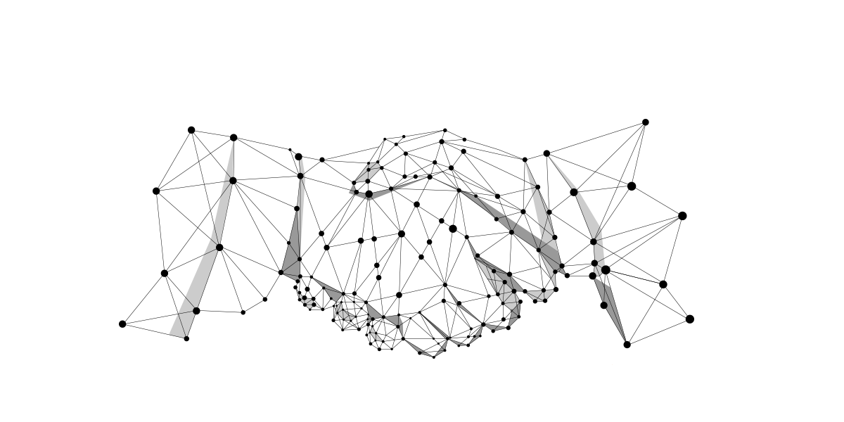


Partner with us
Contact us at
+91 9996444070 - Amitoj Singh
Email us at hello@reelage.com
@reelageofficial
@reelageofficial
www.reelage.com

